Slide 1
ANOVA
Module 3 – Advanced Statistics

Slide 2
Objectives
Concepts using college marks case Study
Sum of squares within groups
Total sum of squares
Sum of squares between groups
Mathematical representation
ANOVA using Excel / R
Assumptions of ANOVA
What if the assumptions are violated ?
Extensions to ANOVA
2

Slide 3
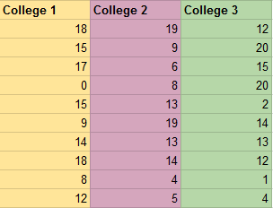
Case Study
Students from three different colleges take the same exam; we wish to see if one college outperforms the other.
We take samples of 10 from each college:
ANOVA (Analysis of Variance): Statistical procedure to test whether or not two or more samples in an experiment vary from each other.
Null hypothesis: There is no significant difference between the groups
Alternative hypothesis: There is significant difference between the groups
3

Slide 4
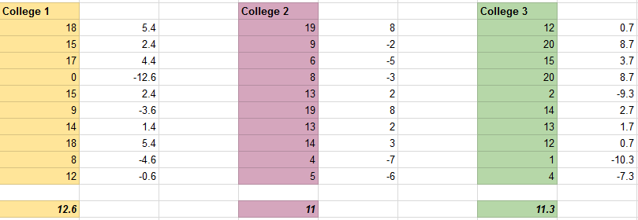
Case Study - Sum of squares within groups
Calculate the mean of each of the groups individually
For each of the groups:
Subtract the mean from the individual values
4

Slide 5
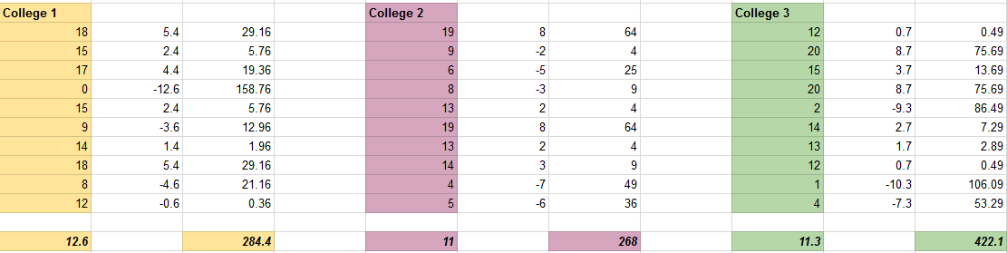
Case Study - Sum of squares within groups
For each of the groups:
Subtract the mean from the individual values
Square the differences and sum these up
Operation: ∑ (Observation – Mean)²
Sum of Squares Within groups (SSW) = 284.4 + 268 + 422.1 = 974.5
5

Slide 6
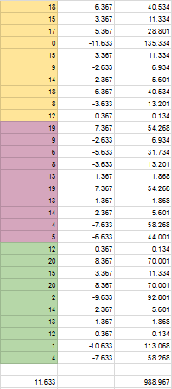
Case Study - Total sum of squares
Take all the samples together and treat them as one sample
Calculate the mean of all samples taken together
Subtract the mean from individual values
Square the individual differences
Sum them up !
Total Sum of Squares (SST) = 988.967
6

Slide 7
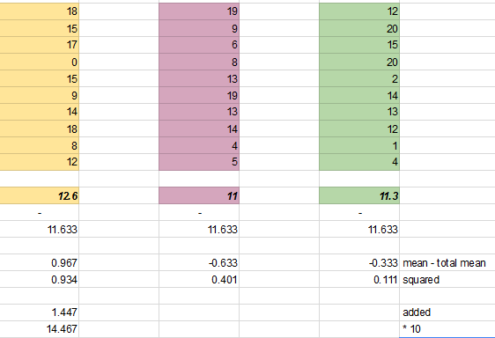
Case Study - Sum of squares between groups
Take the individual means of each of the groups
Subtract the total mean
Square the differences and add them up
Multiply by the number of values in each sample.
Sum of Squares Between Groups (SSB) = 14.467
7

Slide 8
ANOVA – mathematical equation
Total Sum of Squares = Sum of Squares Within groups + Sum of Squares Between Groups
SST = SSW + SSB
i.e. 988.967 = 974.5 + 14.467
Final Calculations:
Sum of squares between groups = Sum of squares between groups = 7.233
Degrees of freedom Number of groups -1
Sum of squares within groups = Sum of squares within groups = 36.093
Degrees of freedom Number of observations – groups
F ratio = Mean Square Between = 0.200
Mean Square Within
8

Slide 9
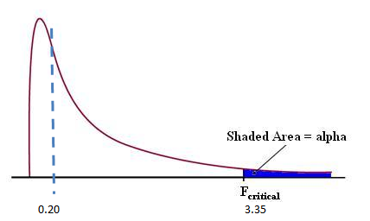
ANOVA – mathematical equation
Calculate the F as:
F(df _ numerator, df_denominator) = F (2, 27) = 3.35
Critical value = 3.35 (for α = 0.05)
F - statistic value = 0.200
Since, we fail to reject the null hypothesis
=> The three groups are not significantly different.
9

